Slide 1


Presented By :Raja Babu
Roll no: 42
Branch :CSE(A.I)
Section: B

Slide 2
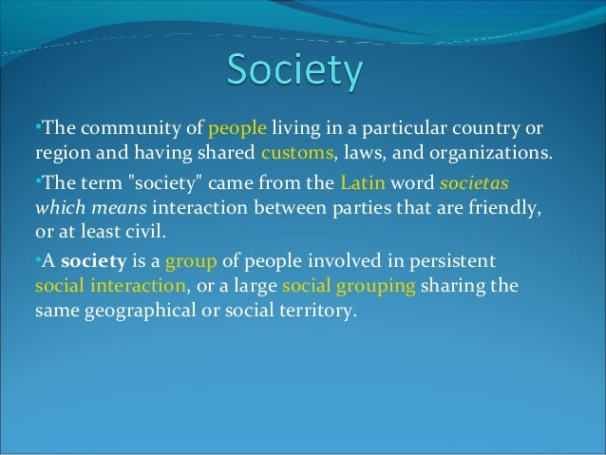

Slide 3


Slide 4
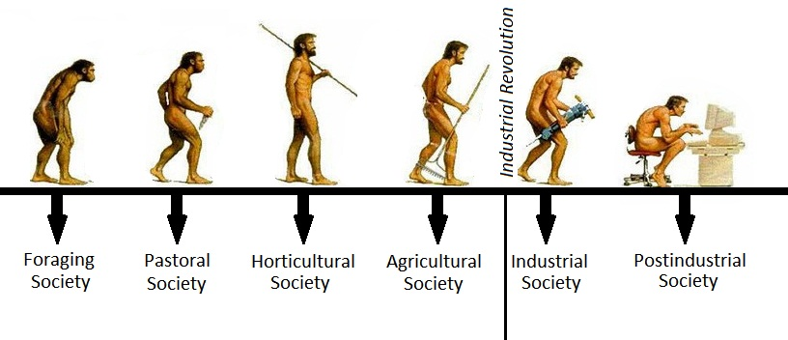
Types of society

Slide 5
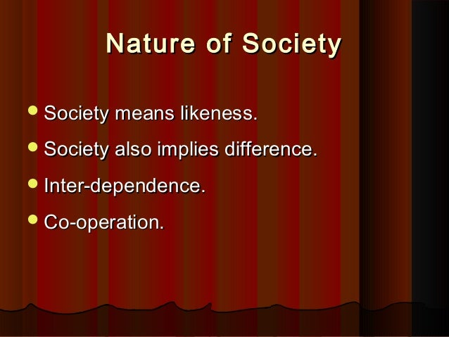

Slide 6
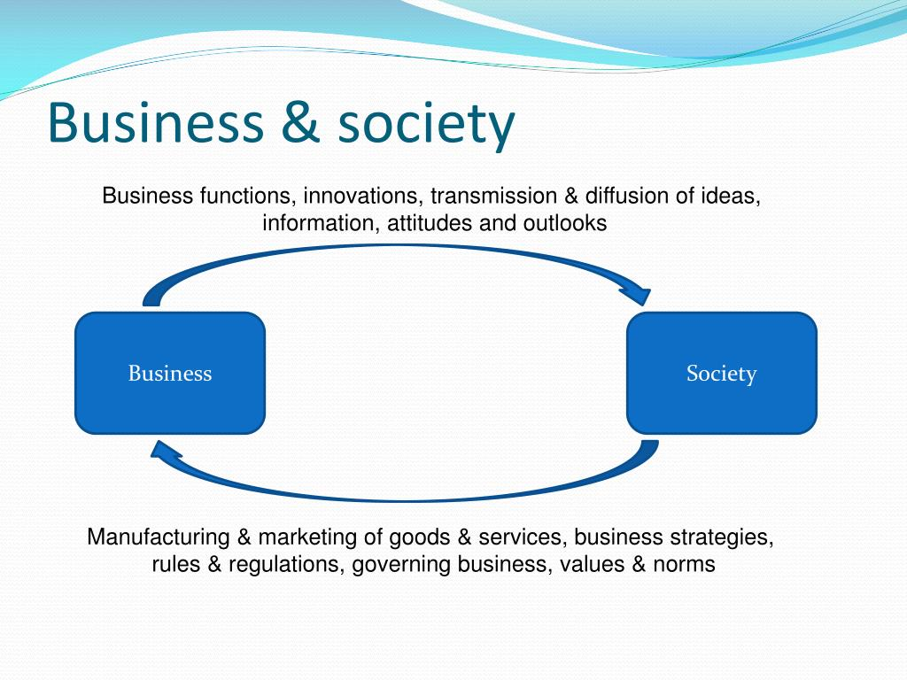

Slide 7


Slide 8
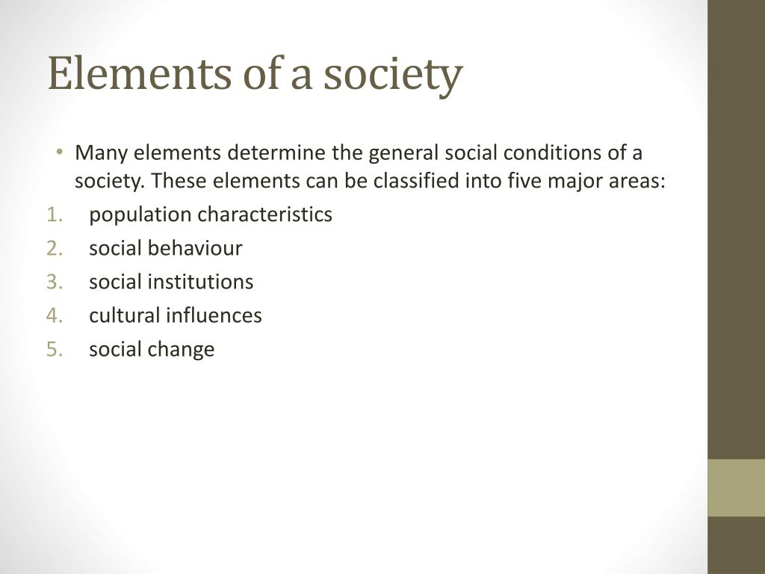

Slide 9


